Slide 1
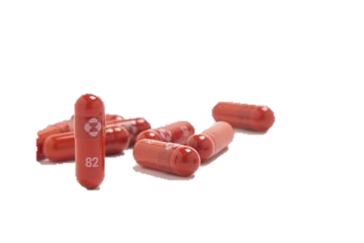
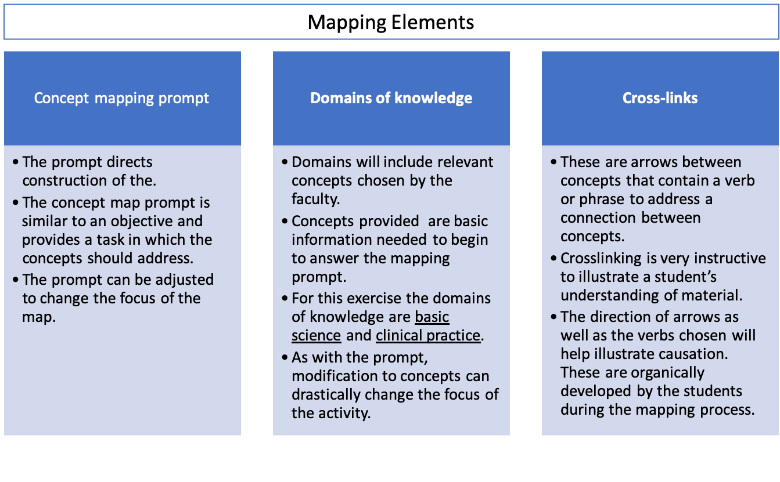
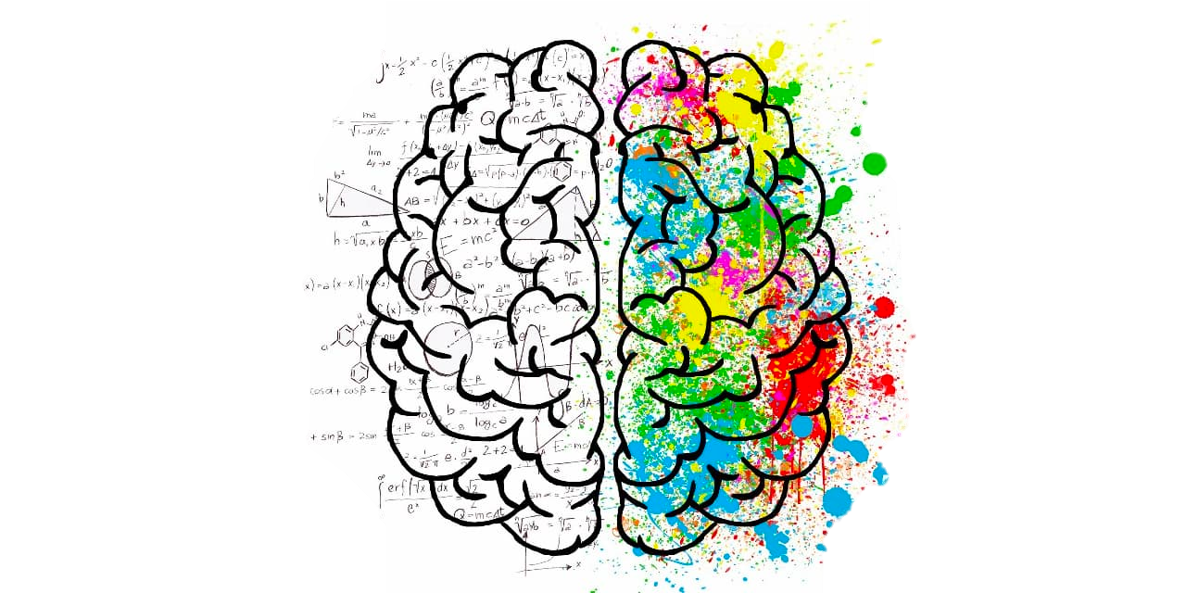
“STEP-1 going Pass-Fail: Seizing a Curricular Opportunity”
Andrew P. Binks, Ph.D., Jennifer Cleveland, PharmD, BCPS, MBA, Renee J. LeClair, Ph.D.
Virginia Tech Carilion School of Medicine
Example week: Second-year curriculum
Monday | Tuesday | Wednesday | Thursday | Friday
Preparation time | Illness Script | Preparation time | Concept Map | PBL Cases Pulmonary hypertension
 |  | PBL Cases
PBL Cases | Preparation time |  | Preparation time
 |  |  |  | Keith's Wrap-up
Background: The over-emphasis of STEP-1 score in residency selection had a detrimental impact on medical student well-being and learning behaviors. Use of external ‘high-yield’ resources left classrooms empty and students likely engaging in grade-focused, extrinsic learning. Despite this, students were effective independent learners and successful on STEP-1. The recent change in STEP-1 grading to pass-fail allows learners to adopt deeper-learning strategies, but also the need to distinguish themselves from other candidates in other ways. We have designed and implemented a new second year curriculum to support the transition of novice learners to expert thinkers, with the aim to make them more successful in clerkships, score better in STEP-2 and remain competitive residency candidates.
Process of Curriculum Development
What is an illness script?
Specifications based grading rubric
Problem Identification
Needs Assessment of Targeted Learners
Goals and Specific Objectives
Educational Strategies
Implementation
Evaluation and Feedback
An Illness script is used to organize case information including:
Epidemiology Prevalence Mortality Risk factors | Signs and symptoms As related to the presentation
Pathophysiology Underlying disease process | Diagnostics and Treatment Laboratory values Imaging Pharmacological Non-pharmacological Social Behavioral
 |  | Pass | Fail
Product | Content | All relevant concepts are included | Few relevant facts or concepts are included or correct
 | Logic and understanding | Understanding of facts and concepts is clearly demonstrated by correct concept-links | Poor understanding of facts and concepts with significant errors in links
 | Integration | The relationship between clinical and basic science concepts is clearly shown by valid cross-links between these domains | Few relationships between clinical and basic science concepts are shown or are correct
 | Illness script | Illness script is neat, clear, legible, has easy-to-follow and has no spelling errors | Illness script is untidy and information is difficult to follow and spelling errors
Process | Participation | All members participate effectively. | Members do not participate.
 | Collaboration | Individuals working in a team contribute equally; Members encourage input from each other equally; Individuals working in a team | Certain members appear to dominate or refrain from contributing; no established collaborative relationships; unable to reach agreement.
 | Team Dynamics | Members are able to reflect on team process and react to dynamics to achieve efficient team functioning; individual contributions are blended to generate a cohesive product | There is no efficiency to team functioning; no distinct roles; unable to reach agreement or produce a cohesive product.
 | Communication | Group demonstrates the ability to communicate and work effectively and treats all members with respect and sensitivity. | Group is unable to communicate and work effectively. Discord is evident in the team.
Grade-orientated learning, a diminished role of faculty in exam-preparation and undervalued classroom activities.
The needs of a new curricular model were identified as 1) promoting deep learning and critical thinking, 2) harness the impact of social learning and promote positive team dynamics, 3) maintaining time for autonomous learning, and 4) provide new opportunities for authentic assessment.
What is an concept map?
The collective outcome was to further distinguish VTCS students
A concept map is a visual representation of connections between a clinical presentation and the learners understanding of the etiology.
Illness script
Concept map
Individualized
Preparation
To support in class assessed actives across the week
Binary assessment
Growth Mindset
Conclusion/Discussion: The change in STEP-1 scoring represented a monumental shift in medical education in the United States. Embracing this change afforded the opportunity to develop a novel, contemporary medical curriculum that supports our learners in the transition to expert, team-orientated physicians.
Acknowledgements: This project is currently funded by the VT Center for Teaching and Learning. We would like to thank the faculty of DBSE for their contributions to the project design and implementation.

